Slide 1
Lending Club Case Study
HEMANT BAGADE
SAHIL NAYAB

Slide 2
Objective
The Objective of this case study is to implement EDA technique on a real world problem and to understand the insights.
Benefits of the case study:
Gives a idea about how EDA is used in real life business problems.
It also develops a basic understanding of risk analytics in banking and financial services.
It improves our understating of visualization and what charts to use for real life data.

Slide 3
Business Understanding
Business objective is to take decision when loan application is received, Check whether to reject or approve the loan.
Dataset details:
The data given below contains information about past loan applicants and whether they ‘defaulted’ or not. Data has details regarding approved loan not the rejected ones. It has 3 status of loan which is Fully Paid, Current and Charged-Off.
Importing the Data
Removing large null value columns
Removing irrelevant columns
Removing/Fixing null values
Correcting data types and deriving new columns
Filter Data for requirement.
Removing Duplicate Data
Removing outliers

Slide 4
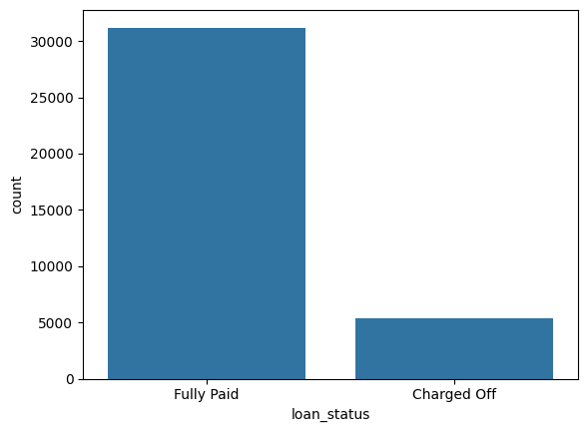
Loan Status and Amount
Loan Status: The number of charged off
Is much smaller compared to total count

Slide 5
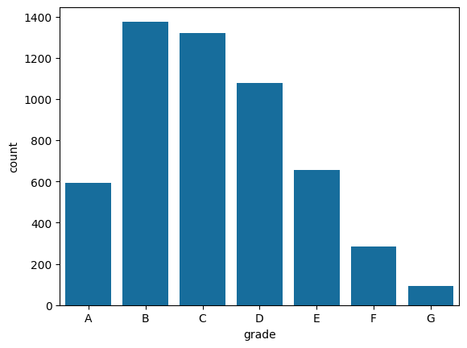
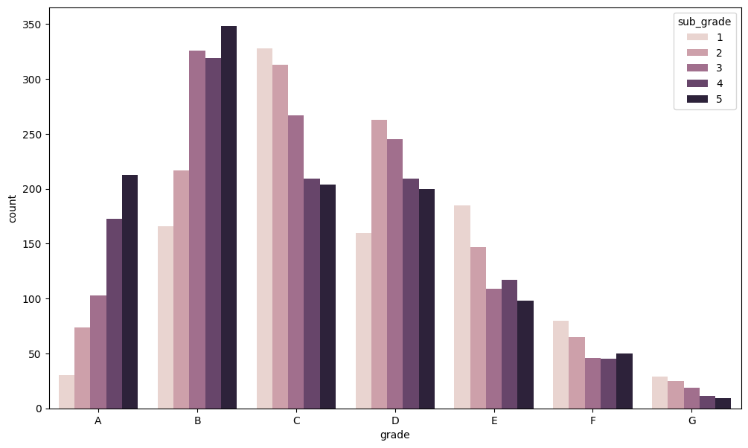
Grades and Sub Grades
Grade: Loan approved are higher grade
Sub-Grades: Grade ‘B5’ has higher count against all
Other grades

Slide 6
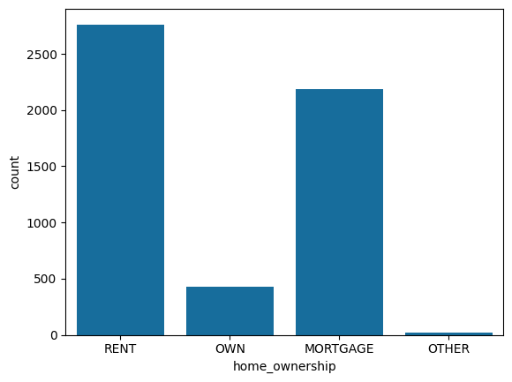
Employment length & Home ownership
Employment Length: Majority of clients have
10+ years of experience and has highest
number of defaulted loan
Home Ownership: Majority of clients are lacking ownership of any property and are on rent or mortgage and have a higher chance of defaulting.

Slide 7
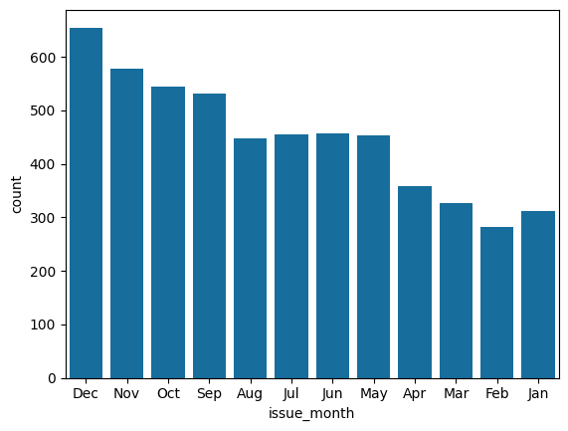
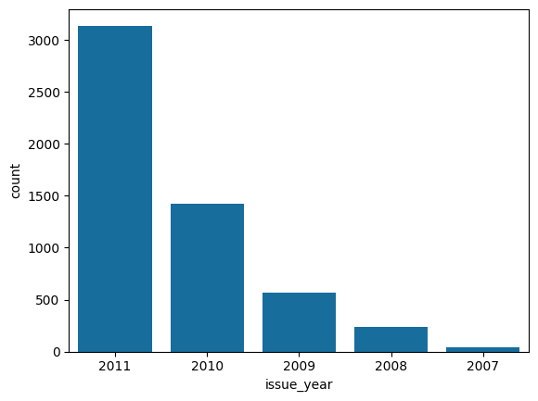
Issue Month and Issue Year
Most loans are defaulted in December of 2011

Slide 8
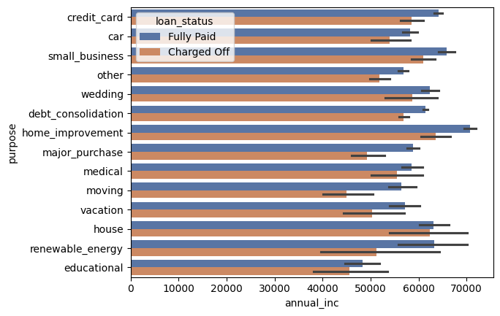
Annual income and loan purpose
Most loans are defaulted when borrowed for
‘home_improvement’

Slide 9
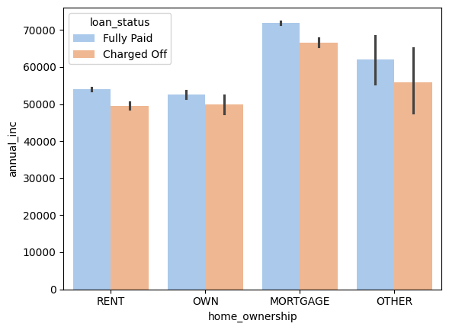
Home ownership and Annual income
Most loans are defaulted when borrower has
‘MORTGAGE’

Slide 10
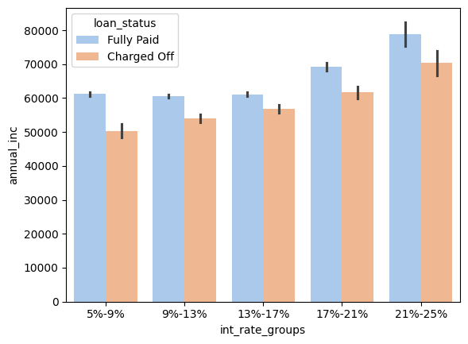
Annual income vs interest rate
Most loans are default when interest rate is between
21% to 25%

Slide 11
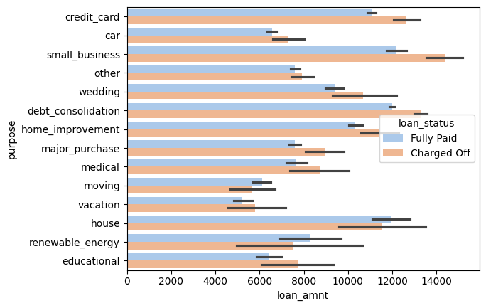
Loan vs loan purpose
Most loans are defaulted when loan is taken for
Paying for another loan

Slide 12
Recommendations
Major driving factors that can be used to predict the defaulting changes are:
DTI
Grades
Verification Status
Annual Income
Home ownership
Grades
Employment experience

